Slide 1
ANAMIKA
AISHWARYA SINGH
HARSHITHA S
JAYA GHOSH
ANAMIKA
AISHWARYA SINGH
HARSHITHA S
JAYA GHOSH

Slide 2
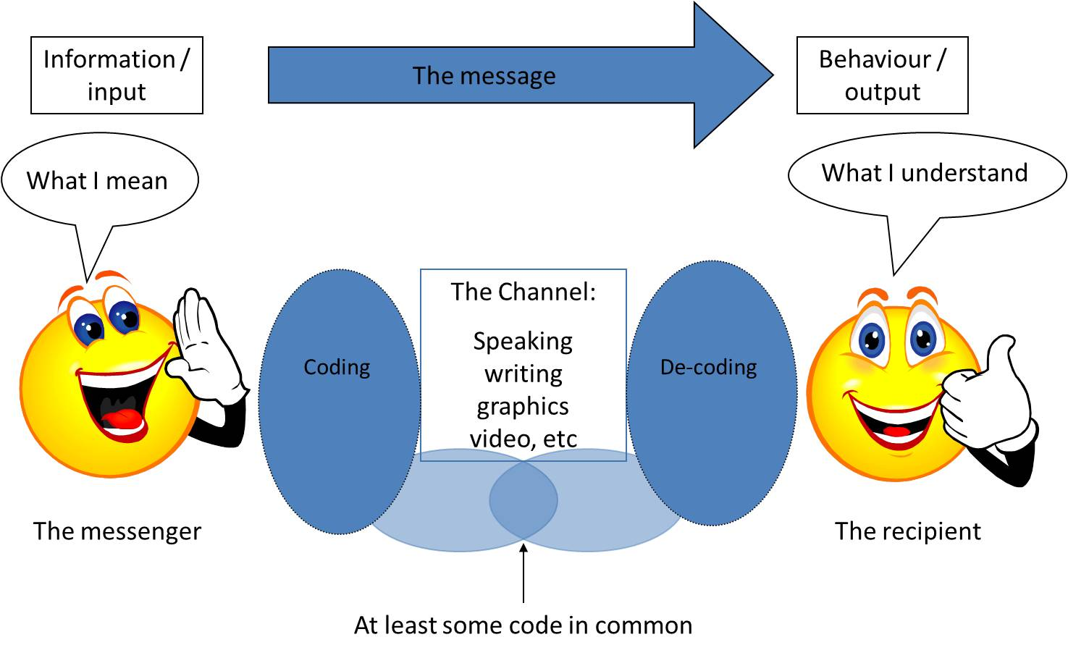
WHAT IS COMMUNICATION?
The act of transferring information from one person to another

Slide 3
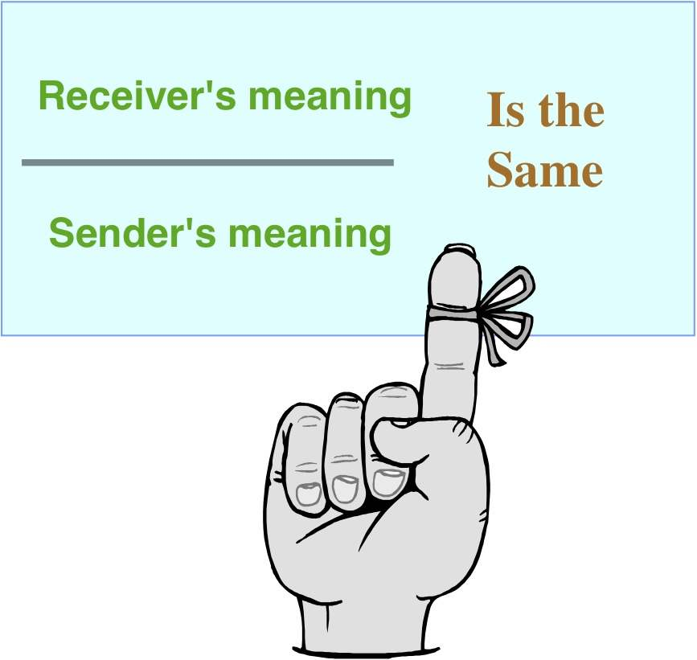
EFFECTIVE COMMUNICATION
The process through which people express feelings about things, themselves, and others.
Expressions of positive and negative feelings about places, objects, events, policies, and ideas are called opinions.

Slide 4
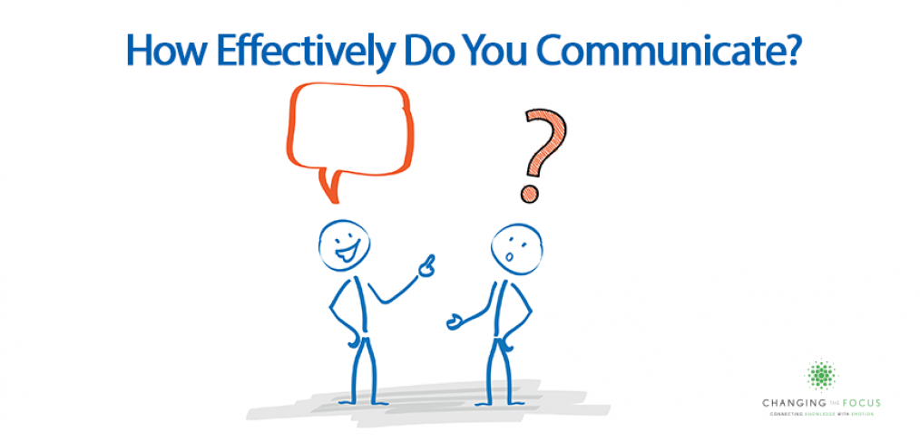

Slide 5

Basic Elements Of Effective Communication
Who? … Who was involved in the story or incident?
What? … What happened?
Where? … Where did it happen?
When? … When did it happen?
Why? … Why did it happen?
How? … How did it happen?

Slide 6
Effective communication combines a set of 4 skills
Engaged listening
Nonverbal communication
Managing stress in the moment
Asserting yourself in a respectful way

Slide 7
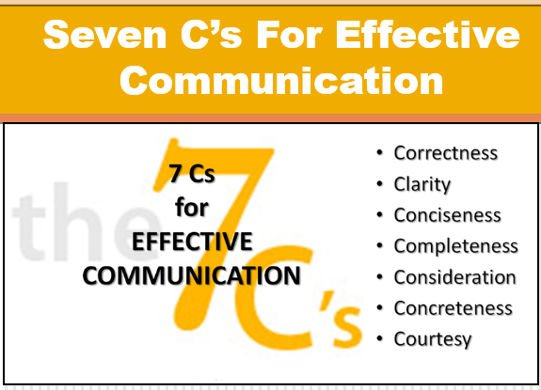

Slide 8
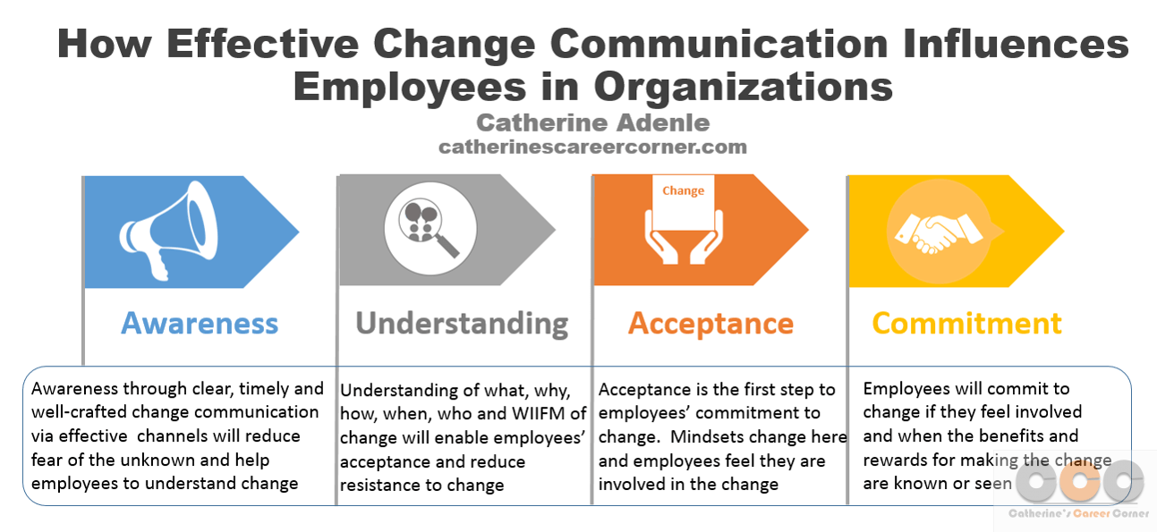
https://youtu.be/I6IAhXM-vps

Slide 9
BARRIERS OF EFFECTIVE COMMUNICATION
Linguistic Barriers
Psychological Barriers
Emotional Barriers
Physical Barriers
Cultural Barriers
Organizational Structure Barriers
Attitude Barriers

Slide 10
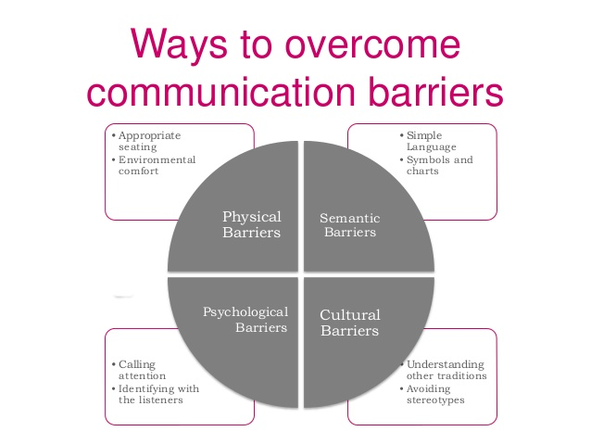
https://youtu.be/JwjAAgGi-90

Slide 11
CONCLUSION
Effective communication can only be accomplished if it is
Simple
Concise
Precise
It is equally important to capture the attention of your audience by giving them what they can understand and benefit from

Slide 12

THANK YOU

